Slide 1



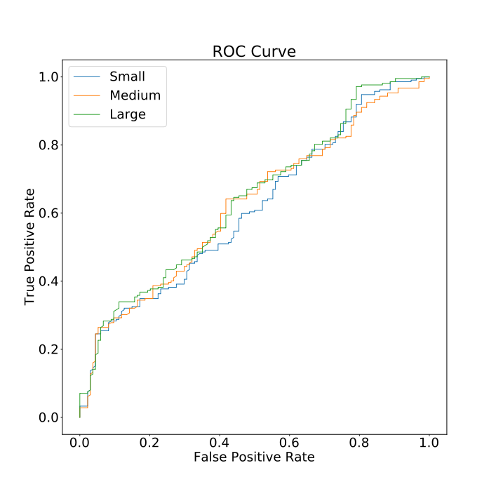
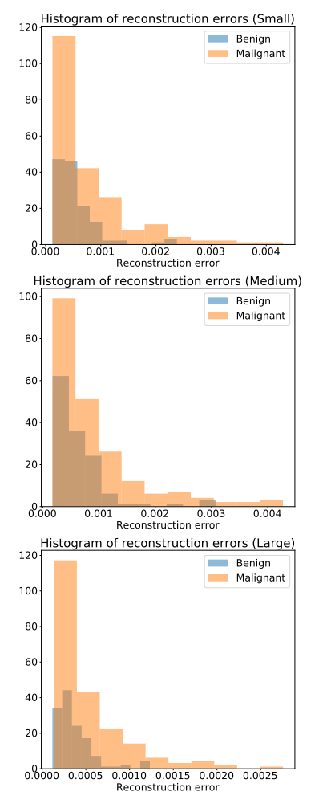
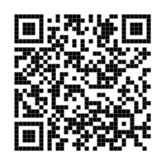
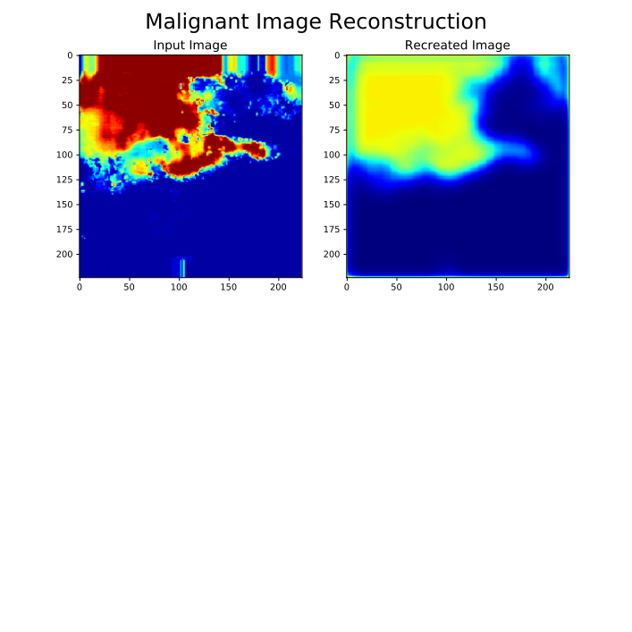
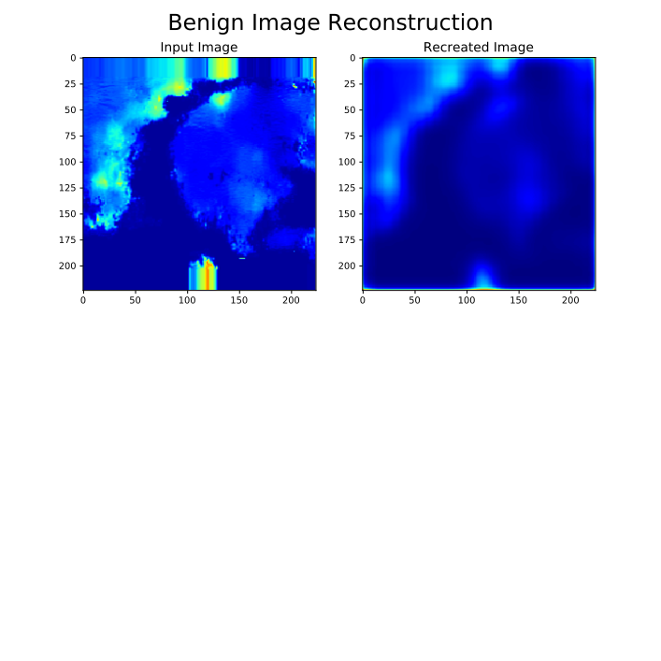
Autoencoders offer relatively poor performance for classification of thyroid ultrasound images
Classification of Thyroid Nodules using
Machine Learned One Class Autoencoders
Joe Adams, Carina Pereira, Manjiri Dighe, Joe Cox, Syndey Rubin, Adam Alessio
Michigan State University, University of Washington
INTRODUCTION
Thyroid nodules are solid lumps that form on your thyroid. These nodules are extremely common in adults. The vast majority of thyroid nodules are harmless, though a very small portion of thyroid nodules are cancerous. Fine Needle Aspiration biopsies are used to determine malignancy, though these procedures are painful and time consuming. To reduce unnecessary FNAs, there is demand for a non-invasive, reliable classification method. Saving hospitals’ money and time, and patients’ necks.
Goals for Classification Tool:
1. Recommend patients with suspicious thyroid nodules for a FNA biopsy.
2. Minimize false negative classifications.
RESULTS
The performance of the autoencoders was monitored using 3 different metrics, the area under a ROC curve (AUC) the accuracy and the specificity at 95% sensitivity. The figures below show the ROC curves for each of the autoencoders, as well as histograms plotting the MSE for the benign and malignant images.
The autoencoders achieved scores are represented in the table below.
METHODS
Three autoencoders were trained using a set of 964 shear wave elastography (SWE) ultrasound images to classify the thyroid nodules. An autoencoder is a type of neural network that uses convolutional layers and max pooling layers to encode and identify key features of input images, then uses convolutional layers and up-sampling layers to reconstruct the images.
Autoencoders of this study (pictured below):
6 Convolutional layers of varying depths ‘N’
3 Max Pooling layers
3 Up-sampling layers
The mean squared error (MSE) can be used to quantify the difference between the input and output images. The autoencoders were trained using only images of benign nodules. The intention is that malignant images (or any different class) should have a higher MSE than benign images providing a continuous variable for classification..
Autoencoder Size | Layer Depth (N) | Trainable Parameters | AUC | Accuracy | Specificity at 95% Sensitivity
Small | 8 | 3,729 | 0.612 | 0.808 | 0.157
Medium | 16 | 14,369 | 0.624 | 0.808 | 0.119
Large | 32 | 56,385 | 0.639 | 0.808 | 0.209
Input Image
Output Image
DISCUSSION
56x56xN
28x28xN
28x28xN
56x56xN
The autoencoders generally performed worse than expected.
Potential reasons for poor performance:
Small dataset
Benign and malignant images not that different
For future research projects, the use of data augmentation to increase the number of trainable images could be useful to increase the viability of autoencoders for classification. Ultimately, despite the less than desirable results of this study, autoencoders as a classification method are an interesting approach to a challenging problem.
224x224x1
112x112x2N
112x112xN
224x224x1
Git Hub:
Adamsj71@msu.edu
Notes:
1

